Slide 1
MODULE 4 Message Integrity and Message Authentication

Slide 2
MESSAGE INTEGRITY
Cryptography systems that discussed so far provide secrecy, or confidentiality, but not integrity.
There are occasions where we may not even need secrecy but instead must have integrity.
.

Slide 3
MESSAGE INTEGRITY
Alice may write a will to distribute her estate upon her death.
The will does not need to be encrypted.
After her death, anyone can examine the will.
The integrity of the will, however, needs to be preserved.
Alice does not want the contents of the will to be changed.
.

Slide 4
Document and Fingerprint
One way to preserve the integrity of a document is through the use of a fingerprint.
Alice can put her fingerprint at the bottom of the document.
Eve cannot modify the contents of this document or create a false document because she cannot forge Alice’s fingerprint.
To ensure that the document has not been changed, Alice’s fingerprint on the document can be compared to Alice’s fingerprint on file.
If they are not the same, the document is not from Alice.
.

Slide 5
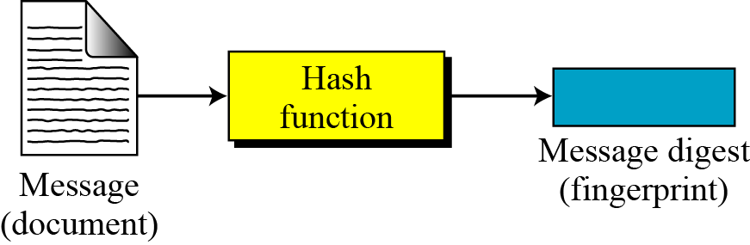
Message and Message Digest
The electronic equivalent of the document and fingerprint pair is the message and digest pair.
To preserve the integrity of a message, the message is passed through an algorithm called a cryptographic hash function.
The function creates a compressed image of the message that can be used like a fingerprint.
Figure 11.1 Message and digest
.

Slide 6
Difference
Two pairs (document/fingerprint) and (message/message digest) are similar, with some differences.
Document and fingerprint are physically linked together.
Message and message digest can be unlinked (or sent) separately, and, most importantly, the message digest needs to be safe from change.
The message digest needs to be safe from change.
.

Slide 7
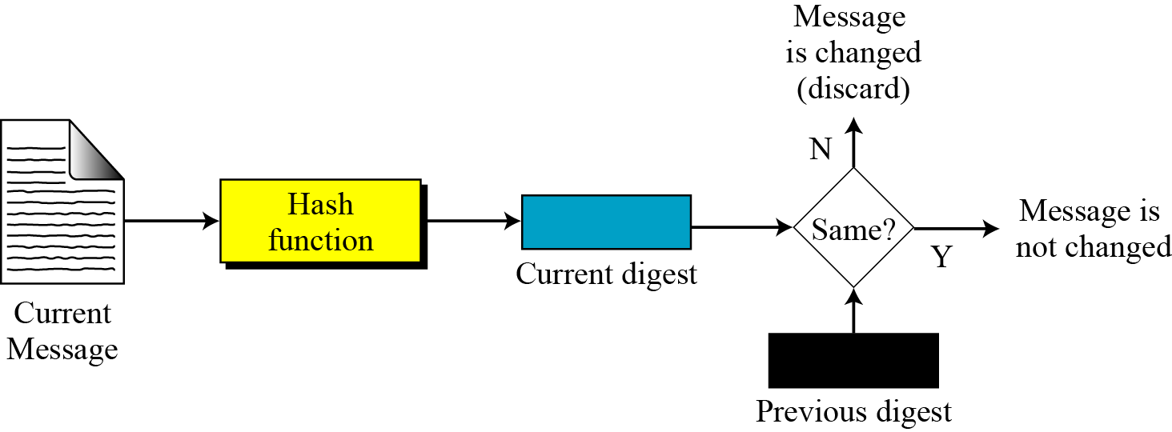
Checking Integrity
Run the cryptographic hash function again and compare the new message digest with the previous one.
Figure 11.2 Checking integrity
.

Slide 8
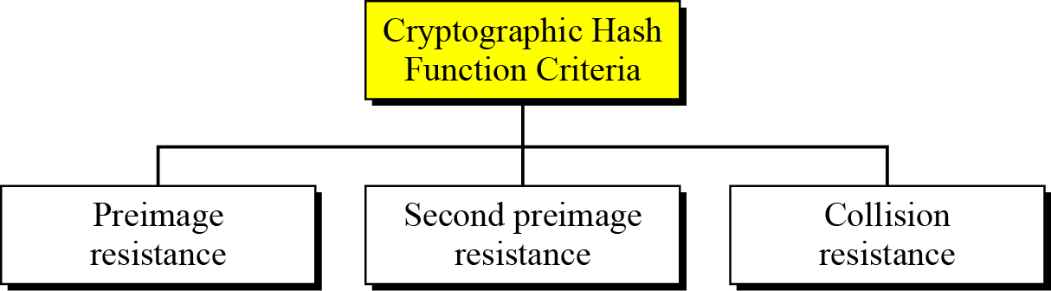
Cryptographic Hash Function Criteria
A cryptographic hash function must satisfy three criteria:
Figure 11.3 Criteria of a cryptographic hash function
.

Slide 9
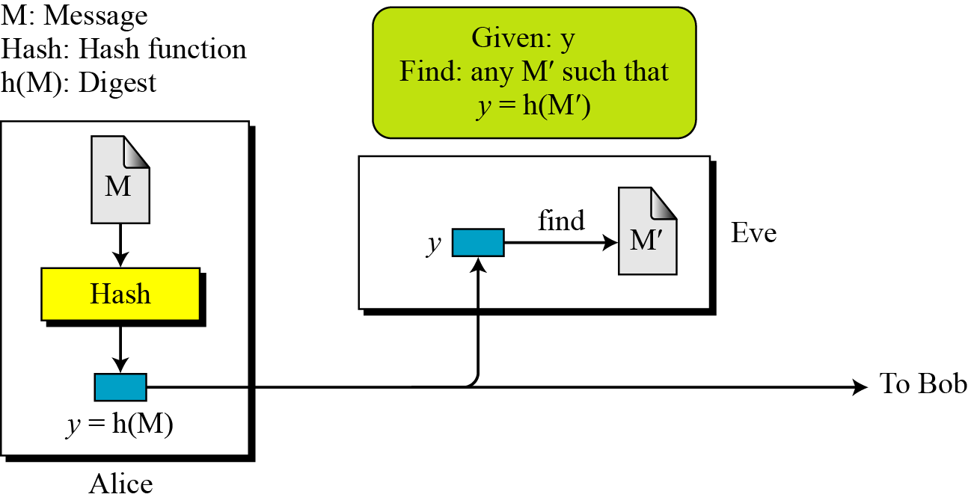
Preimage Resistance
A cryptographic hash function must be preimage resistant.
Given a hash function h and y = h(M), it must be extremely difficult for Eve to find any message, M′, such that y = h(M′).
Figure 11.4 Preimage
.

Slide 10
Preimage Resistance
.

Slide 11
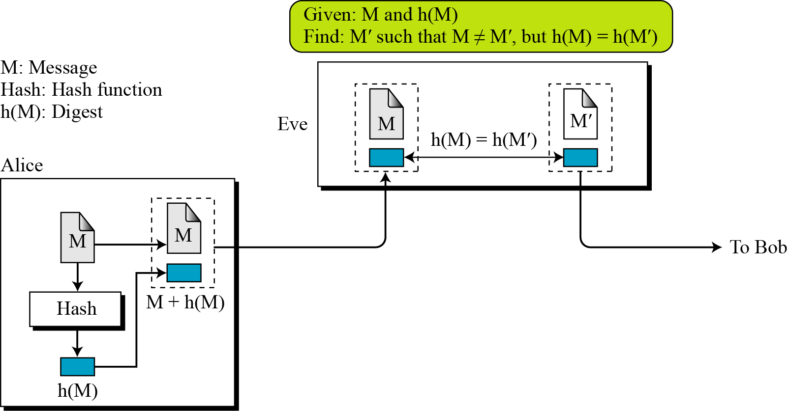
Second Preimage Resistance
.

Slide 12
Second Preimage Resistance
Second preimage resistance, ensures that a message cannot easily be forged.
If Alice creates a message and a digest and sends both to Bob, this criterion ensures that Eve cannot easily create another message that hashes to the exact same digest.
In other words, given a specific message and its digest, it is impossible (or at least very difficult) to create another message with the same digest.
.

Slide 13
Collision Resistance
Ensures that Eve cannot find two messages that hash to the same digest.
Here the adversary can create two messages (out of scratch) and hashed to the same digest.
.

Slide 14
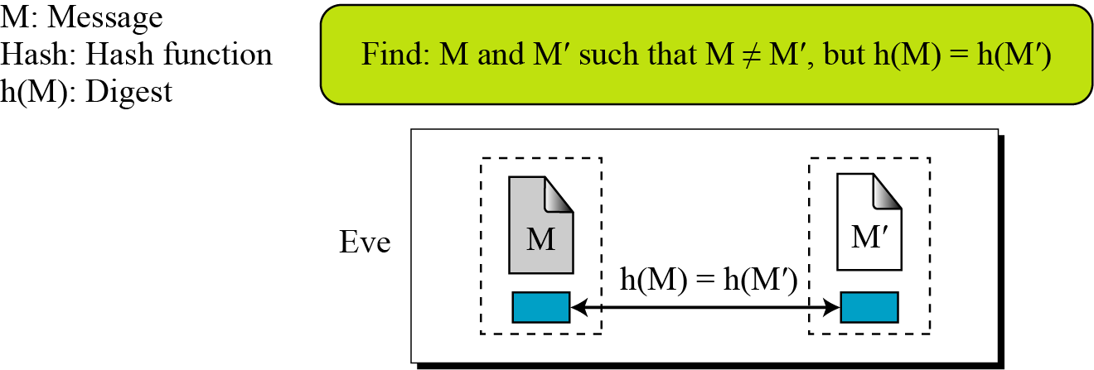
Collision Resistance
.

Slide 15
11.2 RANDOM ORACLE MODEL
is an ideal mathematical model for a hash function.
Introduced in 1993 by Bellare and Rogaway,
A function based on this model behaves as follows:
When a new message of any length is given, the oracle creates and gives a fixed length message digest that is a random string of 0s and 1s.
When a message is given for which a digest exists, the oracle simply gives the digest in the record.
The digest for a new message needs to be chosen independently from all previous digests. oracle cannot use a formula or an algorithm to calculate the digest.
.

Slide 16
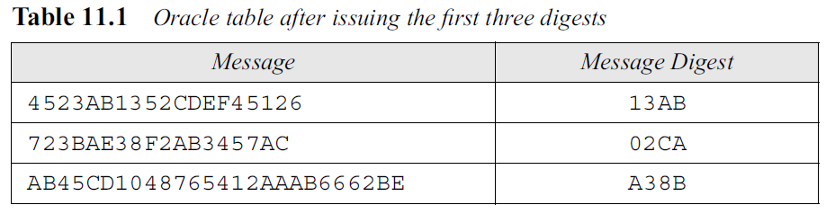
11.2 RANDOM ORACLE MODEL
Example : Assume an oracle with a table and a fair coin.
left column shows the messages whose digests have been issued by the oracle.
second column lists the digests created for those messages.
Assumption: the digest is always 16 bits regardless of the size of the message.
.

Slide 17
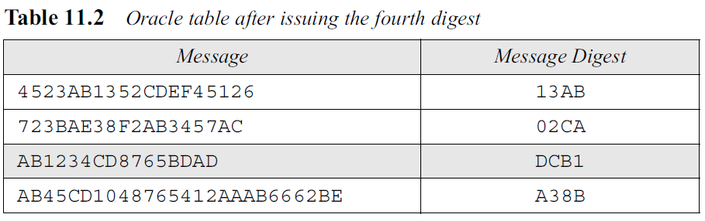
11.2 RANDOM ORACLE MODEL
Now assume that two events occur:
The message AB1234CD8765BDAD is given for digest calculation.
Oracle checks its table. This message is not in the table, so the oracle flips its coin 16 times.
Assume that result is HHTHHHTTHTHHTTTH.
The oracle interprets H as a 1-bit and T as a 0-bit and gives 1101110010110001 in binary, or in hexadecimal, as the message digest for this message and adds message and digest in the table.
.

Slide 18
11.2 RANDOM ORACLE MODEL
b. The message 4523AB1352CDEF45126 is given for digest calculation.
The oracle checks its table and finds that there is a digest for this message in the table (first row).
The oracle simply gives the corresponding digest (13AB).
.

Slide 19
11.2 RANDOM ORACLE MODEL
Oracle in Example 11.3 cannot use a formula or algorithm to create the digest for a message.
For example, imagine the oracle uses the formula h(M) = M mod n.
Now suppose that the oracle has already given h(M1) and h(M2).
If a new message is presented as M3 = M1 + M2, the oracle does not have to calculate the h(M3).
The new digest is just [h(M1) + h(M2)] mod n since
h(M3) = (M1 + M2) mod n = M1 mod n + M2 mod n = [h(M1) + h(M2)] mod n
This violates the third requirement that each digest must be randomly chosen based on the message given to the oracle.
.

Slide 20
11.3 MESSAGE AUTHENTICATION
A message digest guarantees the integrity of a message.
It guarantees that the message has not been changed.
A message digest, however, does not authenticate the sender of the message.
When Alice sends a message to Bob, Bob needs to know if the message is coming from Alice.
To provide message authentication, Alice needs to provide proof that it is Alice sending the message and not an impostor.
.

Slide 21
11.3 MESSAGE AUTHENTICATION
The digest created by a cryptographic hash function is normally called a modification detection code (MDC). The code can detect any modification in the message.
What we need for message authentication (data origin authentication) is a message authentication code (MAC).
.

Slide 22
Modification Detection Code (MDC)
A modification detection code (MDC) is a message digest that can prove the integrity of the message.
If Alice needs to send a message to Bob and be sure that the message will not change during transmission, Alice can create a message digest, MDC, and send both the message and the MDC to Bob.
Bob can create a new MDC from the message and compare the received MDC and the new MDC.
If they are the same, the message has not been changed.
.

Slide 23
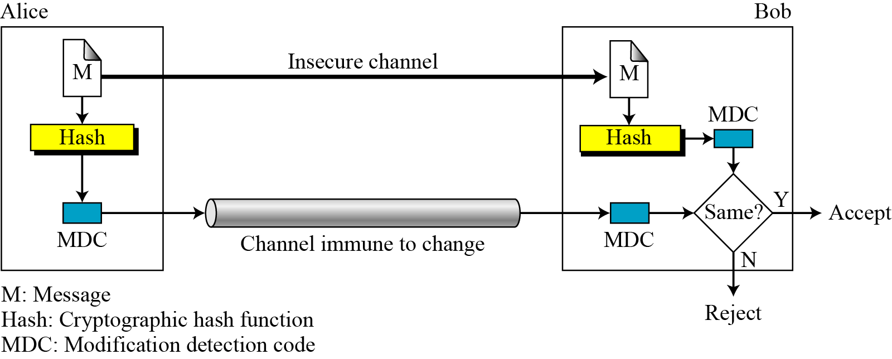
Modification Detection Code (MDC)
.

Slide 24
Modification Detection Code (MDC)
Figure 11.9 shows that the message can be transferred through an insecure channel.
Eve can read or even modify the message.
The MDC, however, needs to be transferred through a safe channel. The term safe here means immune to change.
If both the message and the MDC are sent through the insecure channel, Eve can intercept the message, change it, create a new MDC from the message, and send both to Bob.
Bob never knows that the message has come from Eve.
Note that the term safe can mean a trusted party;
.

Slide 25
Modification Detection Code (MDC)
Alice writes her will and announces it publicly (insecure channel).
Alice makes an MDC from the message and deposits it with her attorney, which is kept until her death (a secure channel).
Although Eve may change the contents of the will, the attorney can create an MDC from the will and prove that Eve’s version is a forgery.
If the cryptography hash function used to create the MDC has the three properties described at the beginning of this chapter, Eve will lose.
.

Slide 26
Message Authentication Code (MAC)
To ensure the integrity of the message and the data origin authentication
ie Alice is the originator of the message, not somebody else
we need to change a modification detection code (MDC) to a message authentication code (MAC).
The difference between a MDC and a MAC is that the second includes a secret between Alice and Bob.
.

Slide 27
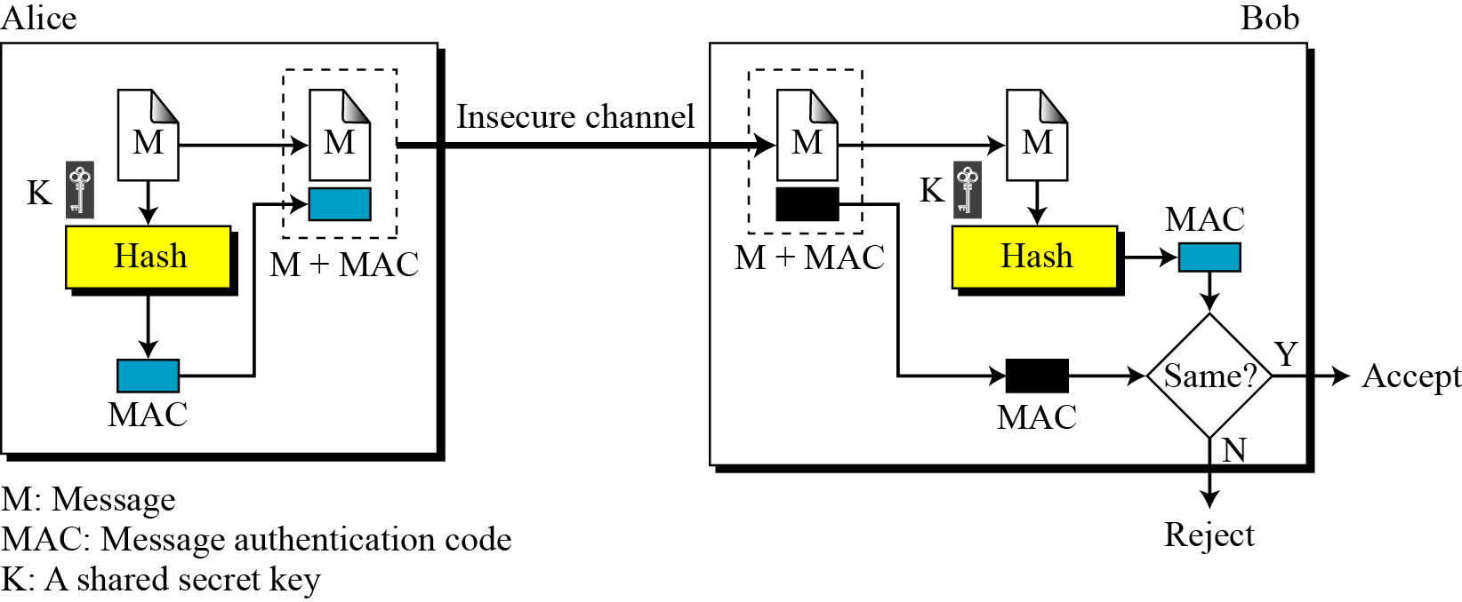
Message Authentication Code (MAC)
.

Slide 28
Message Authentication Code (MAC)
Alice uses a hash function to create a MAC from the concatenation of the key and the message, h (K|M).
She sends the message and the MAC to Bob over the insecure channel.
Bob separates the message from the MAC. He then makes a new MAC from the concatenation of the message and the secret key.
Bob then compares the newly created MAC with the one received.
If the 2 MACs match, message is authentic and has not been modified by an adversary.
.

Slide 29
Message Authentication Code (MAC)
There is no need to use two channels in this case.
.

Slide 30
Message Authentication Code (MAC)
The MAC described is referred to as a prefix MAC because the secret key is appended to the beginning of the message.
We can have a postfix MAC, in which the key is appended to the end of the message.
We can combine the prefix and postfix MAC, with the same key or two different keys.
.

Slide 31
Security of a MAC
Suppose Eve has intercepted the message M and the digest h(K|M). How can Eve forge a message without knowing the secret key? There are three possible cases:
If the size of the key allows exhaustive search, Eve may prepend all possible keys at the beginning of the message and make a digest of the (K|M) to find the digest equal to the one intercepted. She then knows the key and can successfully replace the message with a forged message of her choosing.
2. The size of the key is normally very large in a MAC, but Eve can use another tool: the preimage attack discussed in Algorithm 11.1. She uses the algorithm until she finds X such that h(X) is equal to the MAC she has intercepted. She now can find the key and successfully replace the message with a forged one. Because the size of the key is normally very large for exhaustive search, Eve can only attack the MAC using the preimage algorithm.
3. Given some pairs of messages and their MACs, Eve can manipulate them to come up with a new message and its MAC.
.

Slide 32
The security of a MAC depends on the security of the underlying hash algorithm.
.

Slide 33
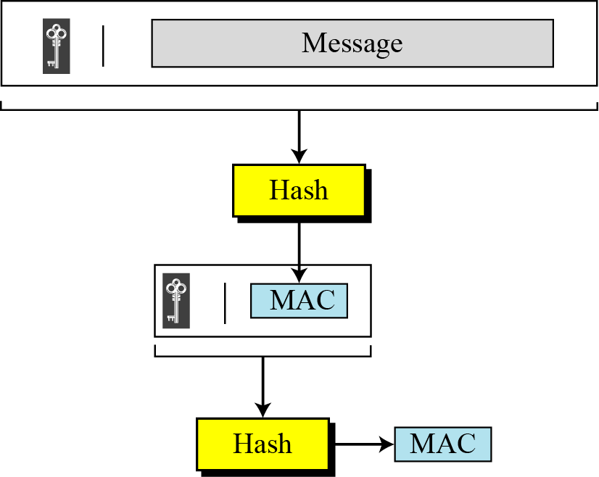
Nested MAC
Figure 11.11 Nested MAC
To improve the security of a MAC, nested MACs were designed in which hashing is done in two steps.
In the first step, the key is concatenated with the message and is hashed to create an intermediate digest.
In the second step, the key is concatenated with the intermediate digest to create the final digest.
.

Slide 34
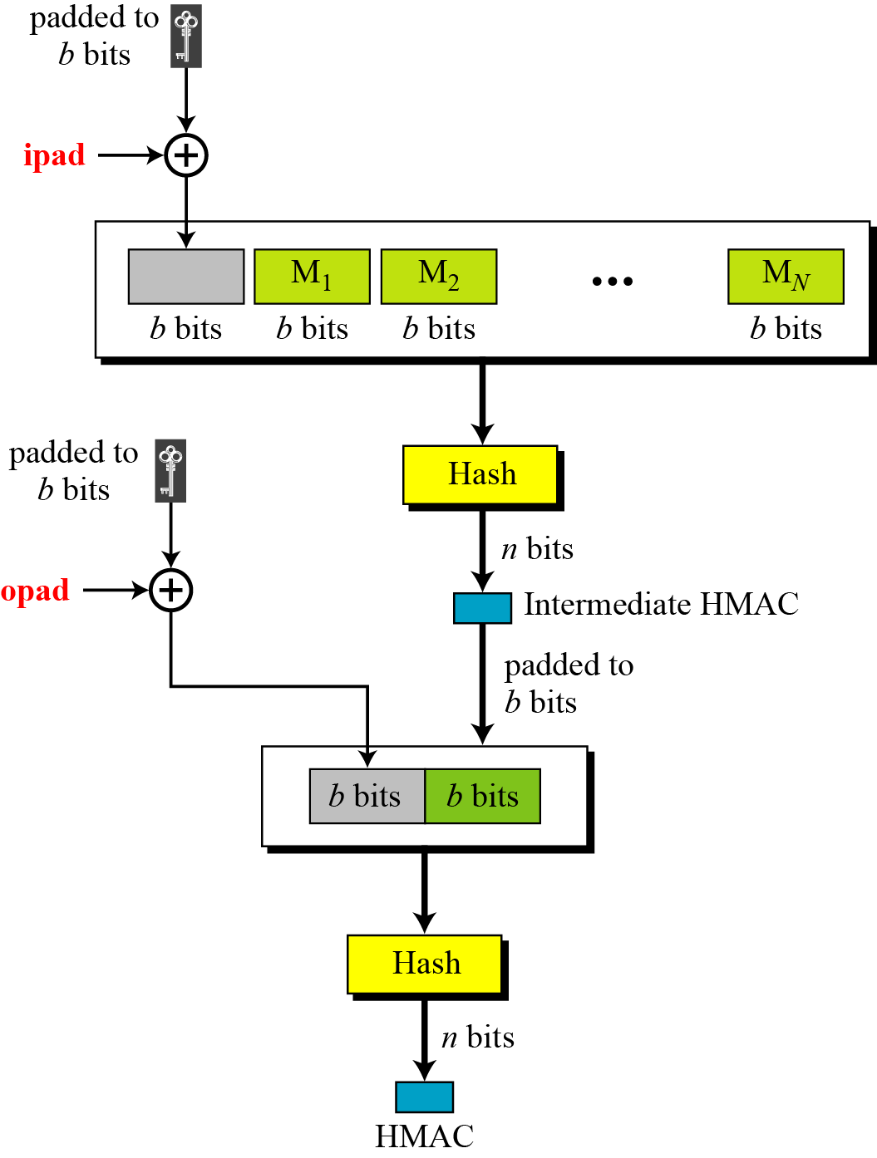
HMAC
NIST has issued a standard for a nested MAC that is often referred to as HMAC.
1. The message is divided into N blocks, each of b bits.
2. The secret key is left-padded with 0’s to create a b-bit key. It is recommended that the secret key (before padding) be longer than n bits, where n is the size of the HMAC.
3. The result of step 2 is exclusive-ored with a constant called ipad (input pad) to create a b-bit block. Value of ipad is the b/8 repetition of the sequence 00110110 (36 in hexadecimal).
4. The resulting block is prepended to the N-block message. The result is N + 1 blocks.
5. Result of step 4 is hashed to create an n-bit digest (intermediate HMAC)
Hash based message authentication code (HMAC)
.

Slide 35
HMAC
NIST has issued a standard for a nested MAC that is often referred to as HMAC.
6. The intermediate n-bit HMAC is left padded with 0s to make a b-bit block.
7. Steps 2 and 3 are repeated by a different constant opad (output pad). The value of opad is the b/8 repetition of the sequence 01011100 (5C in hexadecimal).
8. The result of step 7 is prepended to the block of step 6.
9. Result of step 8 is hashed with the same hashing algorithm to create the final n-bit HMAC.
.

Slide 36
Hash Function
.

Slide 37
12.1 INTRODUCTION
Cryptographic hash function takes a message of arbitrary length and creates a message digest of fixed length.
The two most promising cryptographic hash algorithms- SHA-512 and Whirlpool.
Before discuss some general ideas that may be applied to any cryptographic hash function.
.

Slide 38
Iterated Hash Function
All cryptographic hash functions need to create a fixed-size digest out of a variable-size message.
Creating such a function is best accomplished using iteration.
Instead of using a hash function with variable-size input, a function with fixed-size input is created and is used a necessary number of times.
The fixed-size input function is referred to as a compression function.
It compresses an n-bit string to create an m-bit string where n is normally greater than m.
The scheme is referred to as an iterated cryptographic hash function.
.

Slide 39
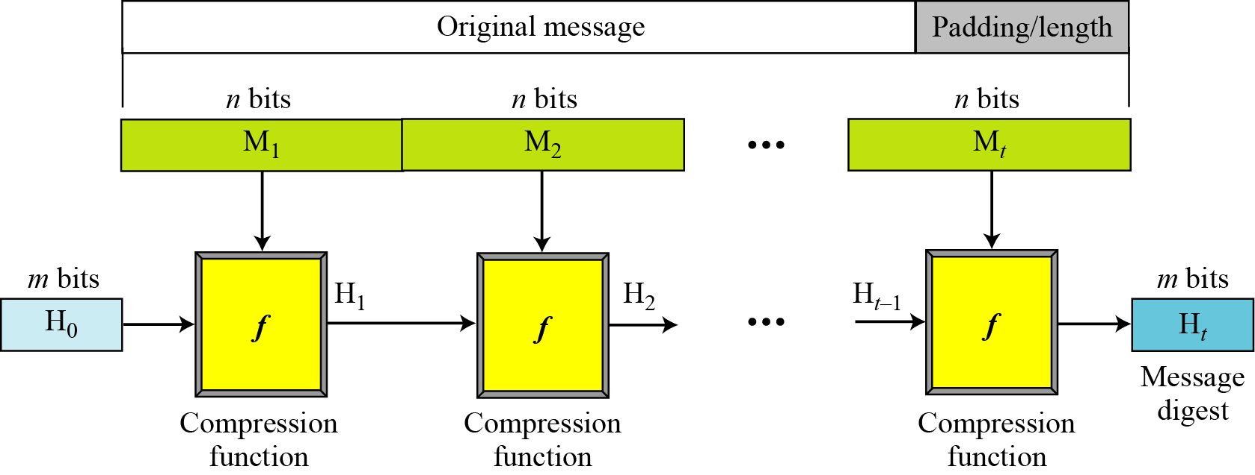
Merkle-Damgard Scheme
The Merkle-Damgard scheme is an iterated hash function that is collision resistant if the compression function is collision resistant.
.

Slide 40
Merkle-Damgard Scheme (contd)
The scheme uses the following steps:
The message length and padding are appended to the message to create an augmented message that can be evenly divided into blocks of n bits, where n is the size of the block to be processed by the compression function.
2. The message is then considered as t blocks, each of n bits. Call each block M₁, M₂,…, M_{t}.
digest created at t iterations H₁, H₂,…, H_{t}.
3. Before starting the iteration, the digest H₀ is set to a fixed value, normally called IV (initial value or initial vector).
4. The compression function at each iteration operates on H_{i−1} and Mi to create a new H_{i}.
H_{i} = ƒ(H_{i−1}, M_{i}), where ƒ is the compression function.
5. H_{t} is the cryptographic hash function of the original message, that is, h(M).
.

Slide 41
If the compression function in the Merkle-Damgard scheme is collision resistant, the hash function is also collision resistant.
.

Slide 42
Two Groups of Compression Functions
Merkle-Damgard scheme is the basis for many cryptographic hash functions today.
Only thing we need to do is design a compression function that is collision resistant and insert it in the Merkle-Damgard scheme.
Two different approaches in designing a hash function.
First approach : compression function is made from scratch: it is particularly designed for this purpose.
Second approach : symmetric-key block cipher serves as a compression function.
.

Slide 43
Hash Functions Made from Scratch
A set of cryptographic hash functions uses compression functions that are made from scratch.
These compression functions are specifically designed for the purposes they serve.
Message Digest (MD)
Several hash algorithms were designed by Ron Rivest.
These are referred to as MD2, MD4, and MD5.
The last version, MD5, is a strengthened version of MD4 that divides the message into blocks of 512 bits and creates a 128-bit digest.
Message digest of size 128 bits is too small to resist collision attack.
.

Slide 44
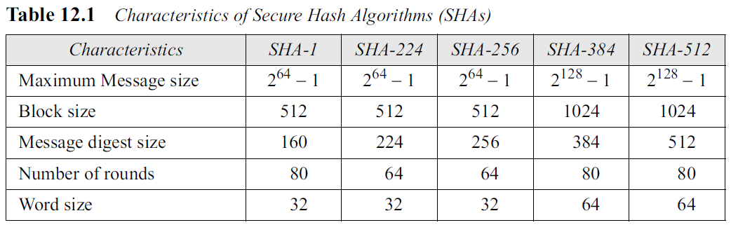
Secure Hash Algorithm (SHA)
The Secure Hash Algorithm (SHA) is a standard that was developed by the National Institute of Standards and Technology (NIST).
It is sometimes referred to as Secure Hash Standard (SHS).
The standard is mostly based on MD5.
The standard was revised in 1995, which includes SHA-1.
It was revised later, which defines 4 new versions: SHA-224, SHA-256, SHA-384, and SHA-512.
All of these versions have the same structure
.

Slide 45
Other Algorithms
RACE Integrity Primitives Evaluation Message Digest (RIPMED) has several versions.
RIPEMD-160 is a hash algorithm with a 160-bit message digest.
RIPEMD-160 uses the same structure as MD5 but uses two parallel lines of execution.
HAVAL is a variable-length hashing algorithm with a message digest of size 128, 160, 192, 224, and 256.The block size is 1024 bits.
.

Slide 46
Hash Functions Based on Block Ciphers
An iterated cryptographic hash function can use a symmetric-key block cipher as a compression function.
There are several secure symmetric-key block ciphers, such as triple DES or AES, that can be used to make a one-way function.
The block cipher in this case only performs encryption.
Several schemes have been proposed.
one of the most promising, Whirlpool.
.

Slide 47
Rabin Scheme
The iterated hash function proposed by Rabin is very simple.
The Rabin scheme is based on the Merkle-Damgard scheme.
The compression function is replaced by any encrypting cipher.
The message block is used as the key;
Previously created digest is used as the plaintext. The ciphertext is the new message digest.
The digest is the size of data block cipher in the underlying cryptosystem.
For example, if DES is used as the block cipher, the size of the digest is only 64 bits.
it is subject to a meet-in-the-middle attack, because the adversary can use the decryption algorithm of the cryptosystem.
.

Slide 48
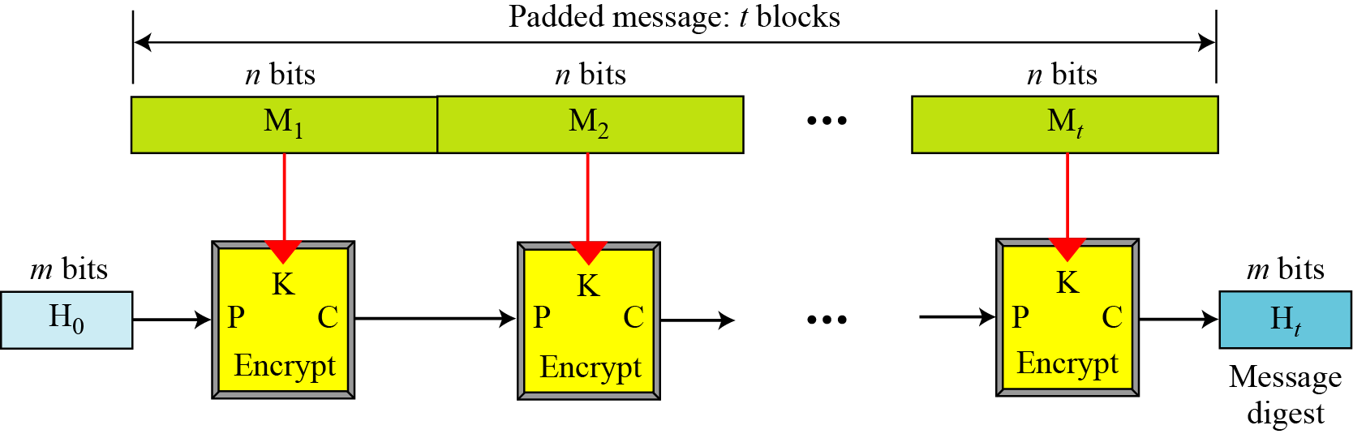
Rabin Scheme
Figure 12.2 Rabin scheme
.

Slide 49
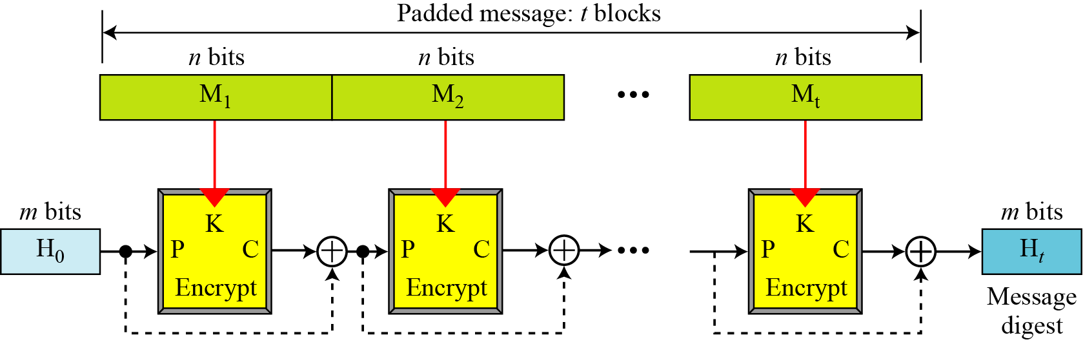
Davies-Meyer Scheme
The Davies-Meyer scheme is basically the same as the Rabin scheme except that it uses forward feed to protect against meet-in-the-middle attack.
Figure 12.3 Davies-Meyer scheme
.

Slide 50
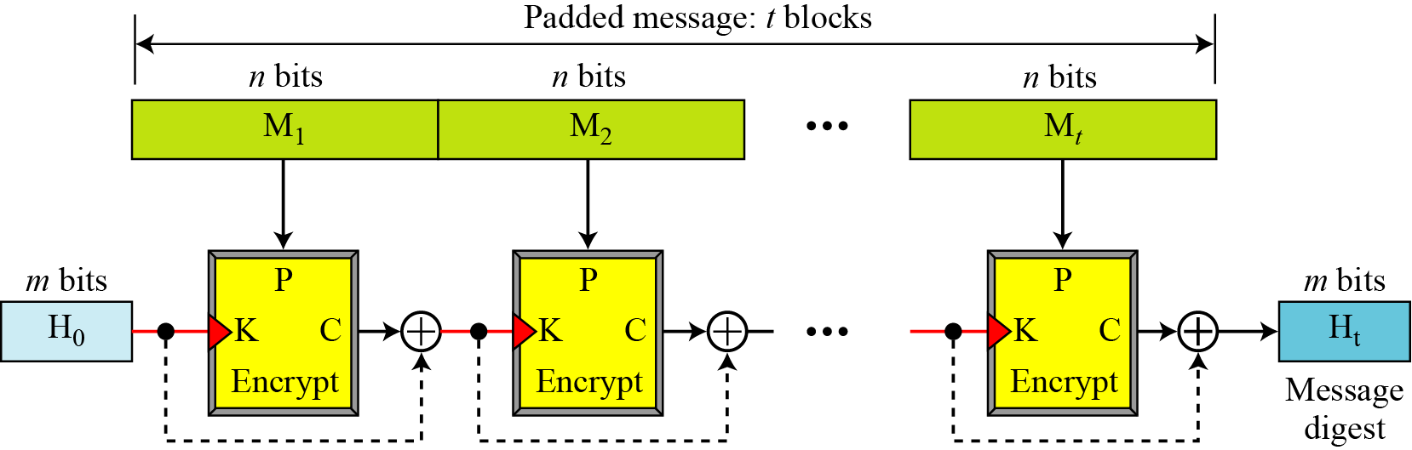
Matyas-Meyer-Oseas Scheme
The scheme can be used if the data block and the cipher key are the same size.
For example, AES is a good candidate for this purpose.
Figure 12.4 Matyas-Meyer-Oseas scheme
.

Slide 51
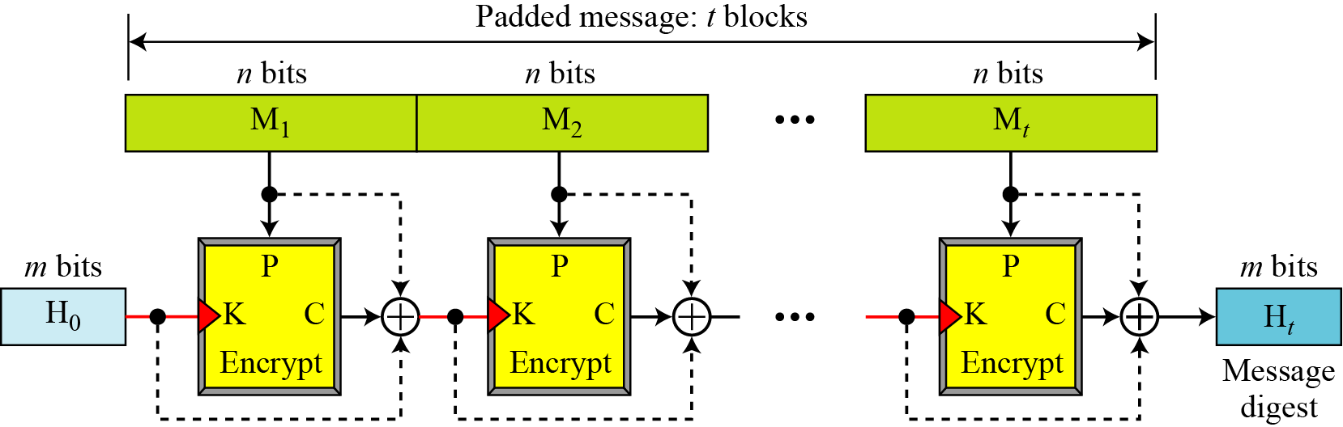
Miyaguchi-Preneel Scheme
Miyaguchi-Preneel scheme is an extended version of Matyas-Meyer-Oseas.
To make the algorithm stronger against attack, the plaintext, the cipher key, and the ciphertext are all exclusive-ored together to create the new digest.
This is the scheme used by the Whirlpool hash function.
Figure 12.5 Miyaguchi-Preneel scheme
.

Slide 52
12.2 SHA-512
SHA-512 is the version of SHA with a 512-bit message digest.
This version, like others SHA family, is based on the Merkle-Damgard scheme.
it is the latest version, it has a more complex structure than the others, and its message digest is the longest.
.

Slide 53
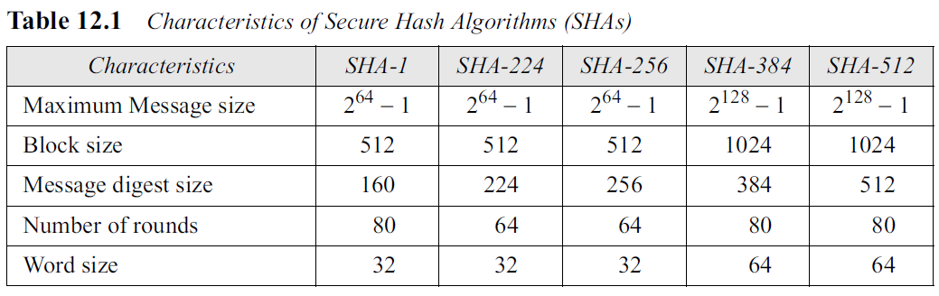
12.2 SHA-512
For characteristics of SHA-512 see Table 12.1.
.

Slide 54
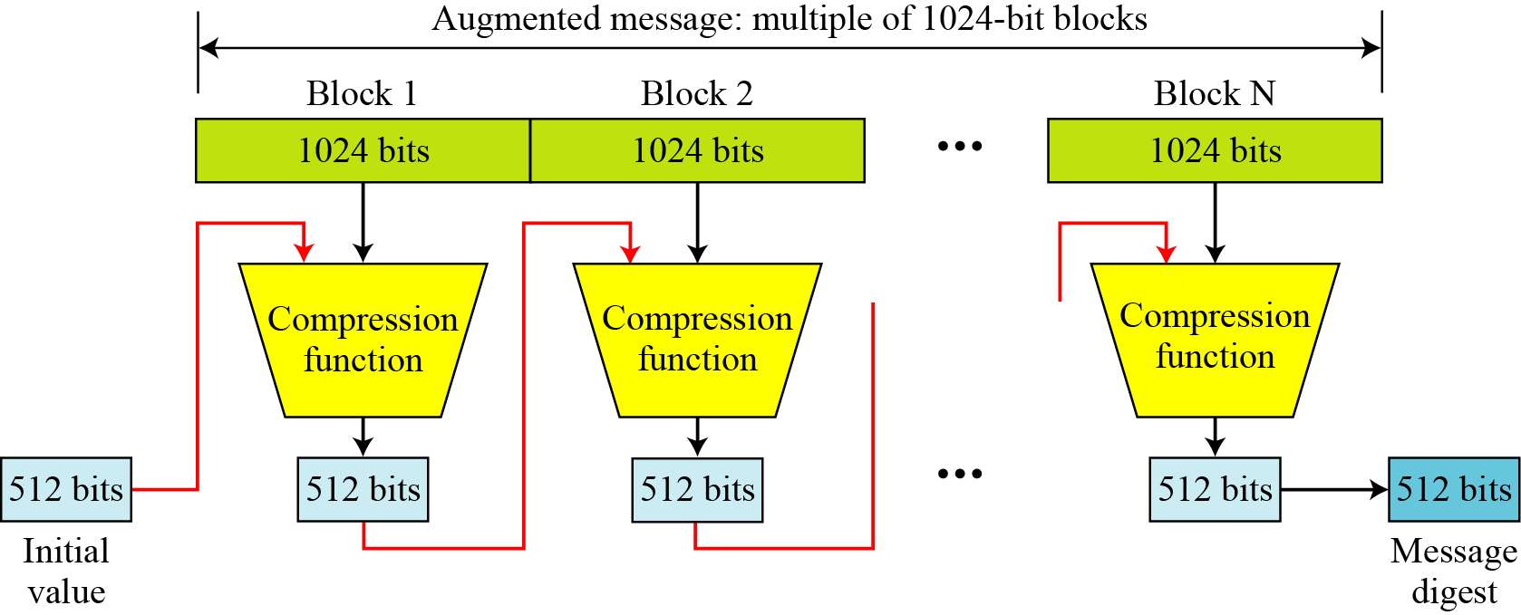
12.2 SHA-512
SHA-512 creates a digest of 512 bits from a multiple-block message.
Each block is 1024 bits in length.
Figure 12.6 Message digest creation SHA-512
.

Slide 55
12.2 SHA-512
The digest is initialized to a predetermined value of 512 bits.
The algorithm mixes this initial value with the first block of the message to create the first intermediate message digest of 512 bits.
This digest is then mixed with the second block to create the second intermediate digest.
Finally, the (N − 1)^{th} digest is mixed with the Nth block to create the N^{th} digest.
When the last block is processed, the resulting digest is the message digest for the entire message.
.

Slide 56
12.2 SHA-512
Message Preparation
SHA-512 insists that the length of the original message be less than 2¹²⁸ bits.
This means that if the length of a message is equal to or greater than 2¹²⁸, it will not be processed by SHA-512.
This is not usually a problem because 2¹²⁸ bits is probably larger than the total storage capacity of any system.
.

Slide 57
12.2 SHA-512
Message Preparation
SHA-512 creates a 512-bit message digest out of a message less than 2¹²⁸.
.

Slide 58
12.2 SHA-512
Length Field and Padding
Before the message digest can be created, SHA-512 requires the addition of a 128-bit unsigned-integer length field to the message that defines the length of the message in bits.
This is the length of the original message before padding.
An unsigned integer field of 128 bits can define a number between 0 and 2¹²⁸ − 1, which is the maximum length of the message allowed in SHA-512.
The length field defines the length of the original message before adding the length field or the padding (Figure 12.7).
.

Slide 59
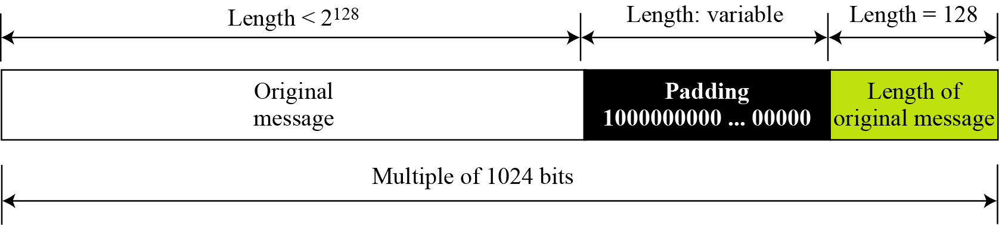
12.2 SHA-512
Length Field and Padding
Figure 12.7 Padding and length field in SHA-512
.

Slide 60
12.2 SHA-512
Length Field and Padding
Before the addition of the length field, we need to pad the original message to make the length a multiple of 1024.
The length of the padding field can be calculated as follows.
Let |M| be the length of the original message and |P| be the length of the padding field.
The format of the padding is one 1 followed by the necessary number of 0s.
.

Slide 61
12.2 SHA-512
Length Field and Padding
What is the number of padding bits if the length of the original message is 2590 bits?
Solution
The padding consists of one 1 followed by 353 0’s.
.

Slide 62
12.2 SHA-512
Length Field and Padding
Example 12.4
Do we need padding if the length of the original message is already a multiple of 1024 bits?
Solution
Yes we do, because we need to add the length field. So padding is needed to make the new block a multiple of 1024 bits.
.

Slide 63
12.2 SHA-512
Example 12.5
What is the minimum and maximum number of padding bits that can be added to a message?
Solution
a. The minimum length of padding is 0 and it happens when (−M − 128) mod 1024 is 0.
This means that |M| = −128 mod 1024 = 896 mod 1024 bits. In other words, the last
block in the original message is 896 bits. We add a 128-bit length field to make the block complete.
b. The maximum length of padding is 1023 and it happens when (−|M| −128) = 1023 mod 1024. This means that the length of the original message is |M| = (−128 −1023) mod 1024 or the length is |M| = 897 mod 1024. In this case, we cannot just add the length field because the length of the last block exceeds one bit more than 1024. So we need to add 897 bits to complete this block and create a second block of 896 bits. Now the length can be added to make this block complete.
.

Slide 64
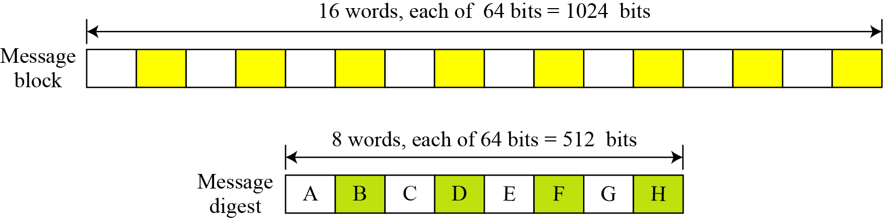
12.2 SHA-512
Words
SHA-512 operates on words; A word is defined as 64 bits.
After the padding and the length field are added to the message, each block of the message consists of sixteen 64-bit words.
Message digest is also made of 64-bit words, but the message digest is only eight words and the words are named A, B, C, D, E, F, G, and H.
.

Slide 65
12.2 SHA-512
Words
16*64=1024
8*64=512
.

Slide 66
12.2 SHA-512
Word Expansion
Before processing, each message block must be expanded.
A block is made of 1024 bits, or sixteen 64-bit words.
We need 80 words in the processing phase.
So the 16-word block needs to be expanded to 80 words, from W₀ to W₇₉.
.

Slide 67
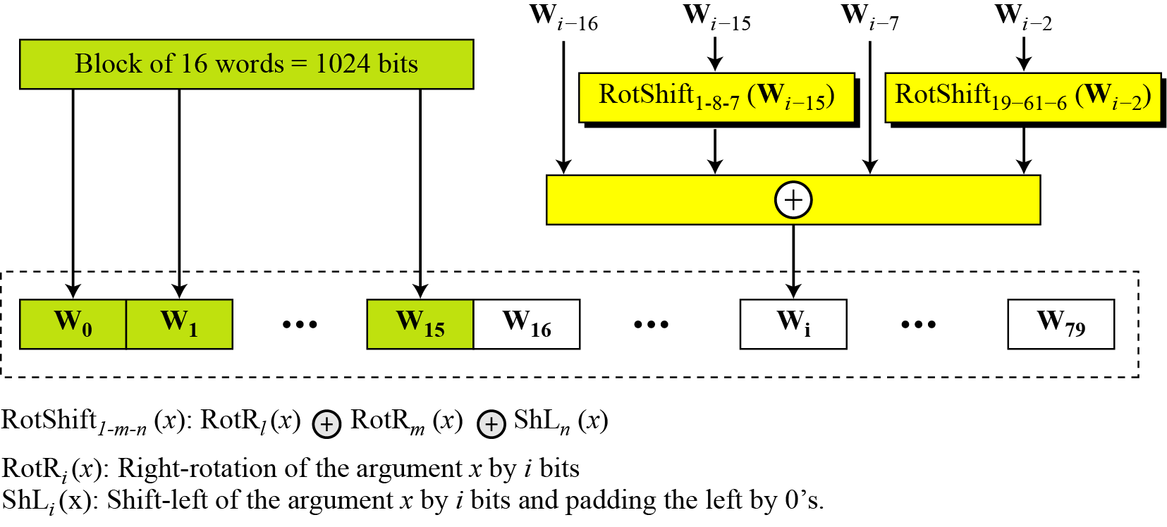
12.2 SHA-512
Word Expansion
The 1024-bit block becomes the first 16 words;
The rest of the words come from already-made words according to the operation shown in the figure.
Figure 12.9 Word expansion in SHA-512
.

Slide 68
12.2 SHA-512
Example 12.6
Show how W₆₀ is made.
Solution
.

Slide 69
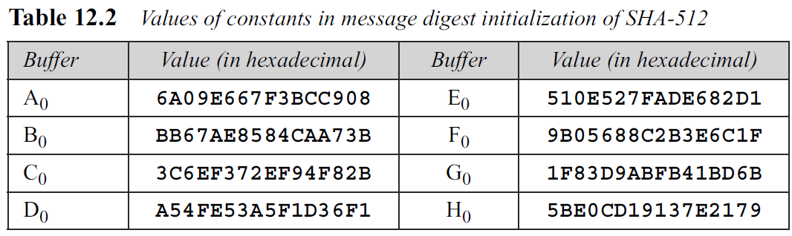
12.2 SHA-512
Message Digest Initialization
The algorithm uses 8 constants for message digest initialization.
Call these constants A₀ to H₀ to match with the word naming used for the digest.
.

Slide 70
12.2 SHA-512
Values are calculated from the first 8 prime numbers (2, 3, 5, 7, 11, 13, 17, and 19).
Each value is the fraction part of the square root of the corresponding prime number after converting to binary and keeping only the first 64 bits.
For example, the eighth prime is 19, with the square root (19)^{1/2} = 4.35889894354.
Converting the number to binary with only 64 bits in the fraction part, we get
SHA-512 keeps the fraction part, (5BE0CD19137E2179)16, as an unsigned integer
.

Slide 71
12.2 SHA-512
Compression Function
SHA-512 creates a 512-bit (eight 64-bit words) message digest from a multiple-block message where each block is 1024 bits.
The processing of each block of data in SHA-512 involves 80 rounds.
Figure 12.10 shows the general outline for the compression function.
.

Slide 72
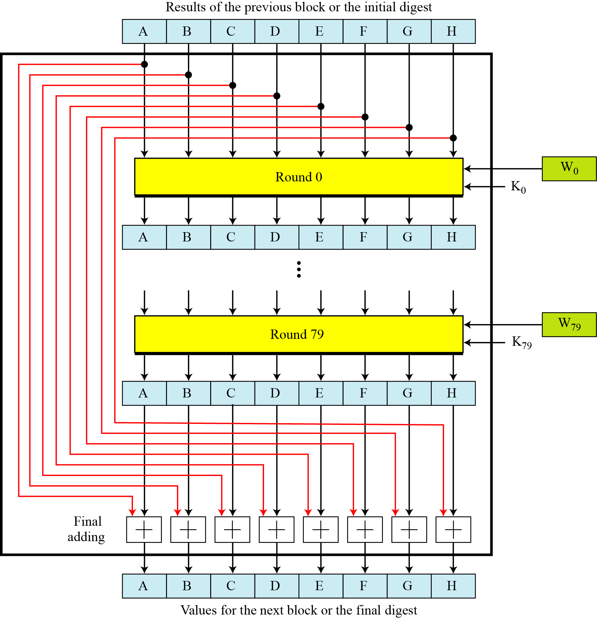
12.2 SHA-512
In each round, the contents of eight previous buffers, one word from the expanded block (Wi), and one 64-bit constant (Ki) are mixed together and then operated on to create a new set of eight buffers.
At the beginning of processing, the values of the eight buffers are saved into eight temporary variables.
At the end of the processing (after step 79), these values are added to the values created from step 79.
We call this last operation the final adding, as shown in the figure.
Compression Function
.

Slide 73
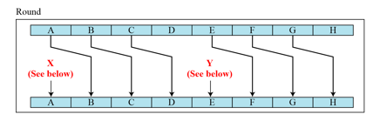
Structure of Each Round
In each round, eight new values for the 64-bit buffers are created from the values of the buffers in the previous round.
As Figure 12.11 shows, six buffers are the exact copies of one of the buffers in the previous round as shown below:
.

Slide 74
Structure of Each Round
Two of the new buffers, A and E, receive their inputs from some complex functions that involve some of the previous buffers, the corresponding word for this round (Wi), and the corresponding constant for this round (Ki).
Figure 12.11 shows the structure of each round.
.

Slide 75
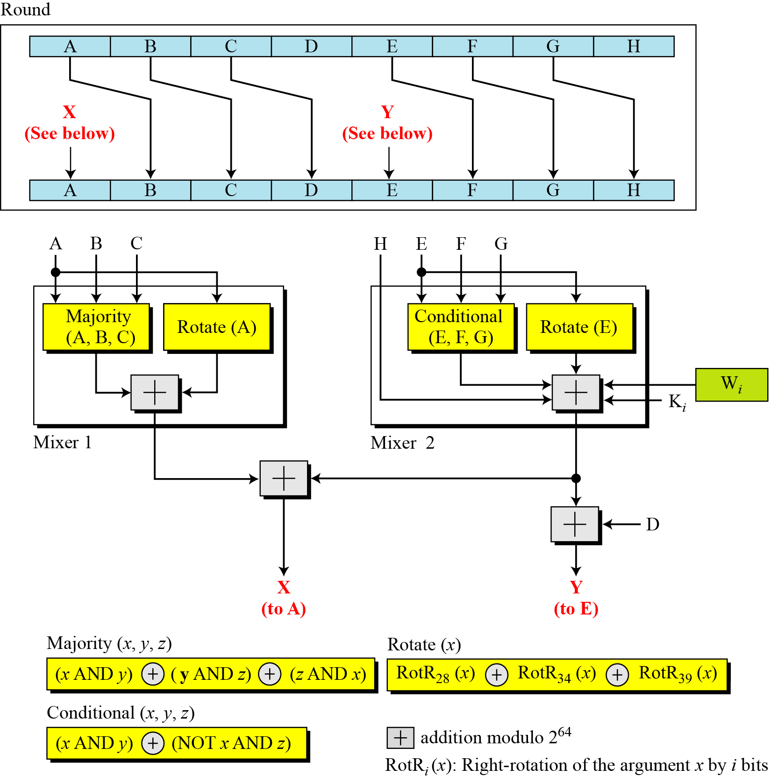
Structure of Each Round
Figure 12.11 shows the structure of each round.
There are 2 mixers, 3 functions, and several operators.
Each mixer combines two functions.
.

Slide 76
Structure of Each Round
Figure 12.11 shows the structure of each round.
1. The Majority function is a bitwise function.
It takes three corresponding bits in three buffers (A, B, and C) and calculates
Resulting bit is the majority of 3 bits.
If 2 or 3 bits are 1’s, the resulting bit is 1; otherwise it is 0.
.

Slide 77
Structure of Each Round
2. The Conditional function is also a bitwise function.
It takes three corresponding bits in three buffers (E, F, and G) and calculates
Resulting bit is the logic “If Ej then Fj; else Gj”.
.

Slide 78
Structure of Each Round
3. The Rotate function right-rotates the 3 instances of the same buffer (A or E) and applies the exclusive-or operation on the results.
4. The right-rotation function, RotRi(x), is the same as the one we used in the wordexpansion process.
It right-rotates its argument i bits; it is actually a circular shiftright operation.
5. The addition operator used in the process is addition modulo 2⁶⁴.
This means that the result of adding two or more buffers is always a 64-bit word.
.

Slide 79
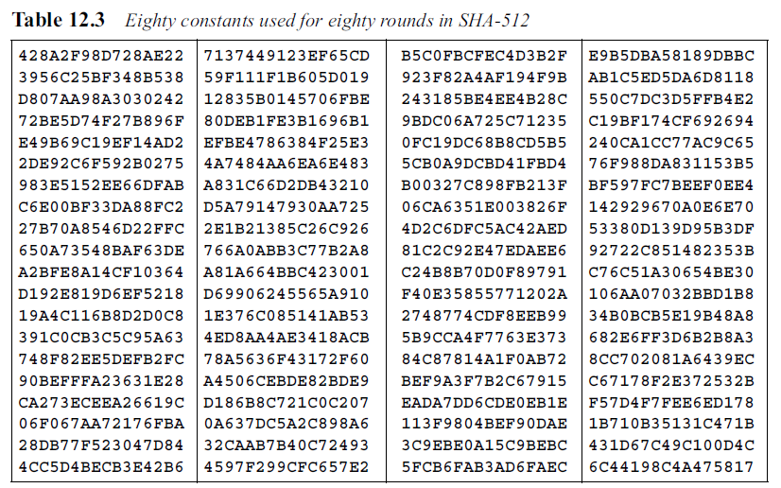
Structure of Each Round
6. There are 80 constants, K₀ to K₇₉, each of 64 bits as shown in Table 12.3 in hexadecimal format (four in a row).
Similar to the initial values for the eight digest buffers, these values are calculated from the first 80 prime numbers (2, 3,…, 409).
.

Slide 80
Structure of Each Round
Each value is the fraction part of the cubic root of the corresponding prime number after converting it to binary and keeping only the first 64 bits.
For example, the 80th prime is 409, with the cubic root (409)^{1/3} = 7.42291412044.
Converting this number to binary with only 64 bits in the fraction part, we get
(111.0110 1100 0100 0100 . . . 0111)₂ → (7.6C44198C4A475817)₁₆
SHA-512 keeps the fraction part, (6C44198C4A475817)₁₆, as an unsigned integer.
.

Slide 81
Structure of Each Round
Example 12.7
We apply the Majority function on buffers A, B, and C.
If the leftmost hexadecimal digits of these buffers are 0x7, 0xA, and 0xE, respectively, what is the leftmost digit of the result?
Solution
The digits in binary are 0111, 1010, and 1110.
a. The first bits are 0, 1, and 1. The majority is 1. We can also prove it using the definition of the Majority function:
b. The second bits are 1, 0, and 1. The majority is 1.
c. The third bits are 1, 1, and 1. The majority is 1.
d. The fourth bits are 1, 0, and 0. The majority is 0.
The result is 1110, or 0xE in hexadecimal.
.

Slide 82
Structure of Each Round
Example 12.8
We apply the Conditional function on E, F, and G buffers.
If the leftmost hexadecimal digits of these buffers are 0x9, 0xA, and 0xF respectively, what is the leftmost digit of the result?
Solution
The digits in binary are 1001, 1010, and 1111.
a. The first bits are 1, 1, and 1. Since E1 = 1, the result is F1, which is 1. We can also use the definition of the Condition function to prove the result:
b. The second bits are 0, 0, and 1. Since E2 is 0, the result is G2, which is 1.
c. The third bits are 0, 1, and 1. Since E3 is 0, the result is G3, which is 1.
d. The fourth bits are 1, 0, and 1. Since E4 is 1, the result is F4, which is 0.
The result is 1110, or 0xE in hexadecimal.
.

Slide 83
12.3 WHIRLPOOL
Is an iterated cryptographic hash function, based on the Miyaguchi-Preneel scheme.
Uses a symmetric-key block cipher in place of the compression function.
Block cipher is a modified AES cipher that has been tailored for this purpose.
Designed by Vincent Rijmen and Paulo S. L. M. Barreto.
Endorsed by the New European Schemes for Signatures, Integrity, and Encryption (NESSIE).
.

Slide 84
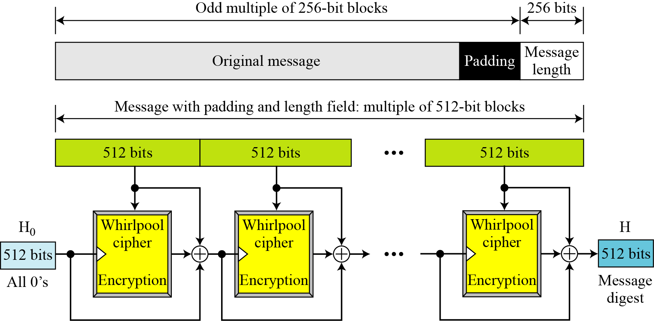
12.3 WHIRLPOOL
Figure 12.12 Whirlpool hash function
.

Slide 85
12.3 WHIRLPOOL
Preparation
Whirlpool requires that the length of the original message be less than 2²⁵⁶ bits.
A message needs to be padded before being processed.
The padding is a single 1-bit followed by the necessary numbers of 0-bits to make the length of the padding an odd multiple of 256 bits.
After padding, a block of 256 bits is added to define the length of the original message.
After padding and adding the length field, the augmented message size is an even multiple of 256 bits or a multiple of 512 bits.
.

Slide 86
12.3 WHIRLPOOL
Whirlpool creates a digest of 512 bits from a multiple 512-bit block message.
The 512-bit digest, H₀, is initialized to all 0’s.
This value becomes the cipher key for encrypting the first block.
The ciphertext resulting from encrypting each block becomes the cipher key for the next block after being exclusive-ored with the previous cipher key and the plaintext block.
Message digest is the final 512-bit ciphertext after the last exclusive-or operation.
.

Slide 87
Whirlpool Cipher
The Whirlpool cipher is a non-Feistel cipher like AES.
Here the Whirlpool cipher is compared with the AES cipher and their differences are mentioned.
Rounds
Whirlpool is a round cipher that uses 10 rounds.
The block size and key size are 512 bits.
The cipher uses 11 round keys, K₀ to K₁₀, each of 512 bits.
.

Slide 88
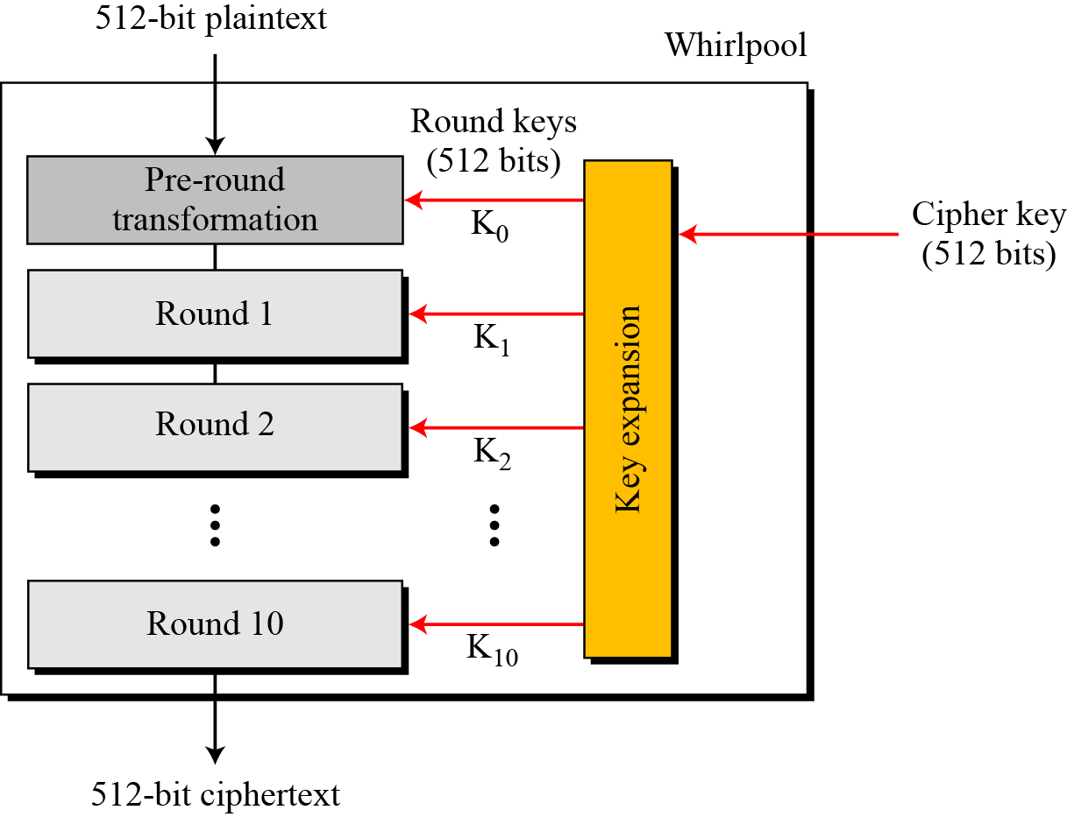
Figure 12.13 General idea of the Whirlpool cipher
Figure 12.13 shows the general design of the Whirlpool cipher.
.

Slide 89
States and Blocks
Like the AES cipher, the Whirlpool cipher uses states and blocks.
However, the size of the block or state is 512 bits.
A block is considered as a row matrix of 64 bytes; a state is considered as a square matrix of 8 × 8 bytes.
.

Slide 90
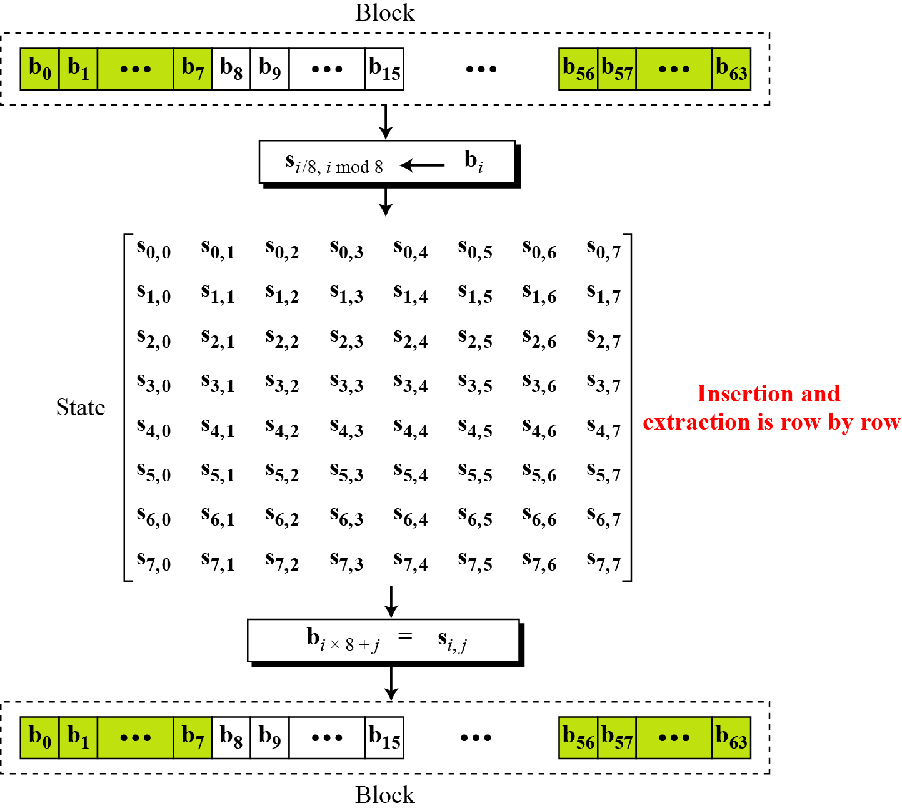
Figure 12.14 Block and state in the Whirlpool cipher
Unlike AES, the block-to-state or stateto- block transformation is done row by row.
.

Slide 91
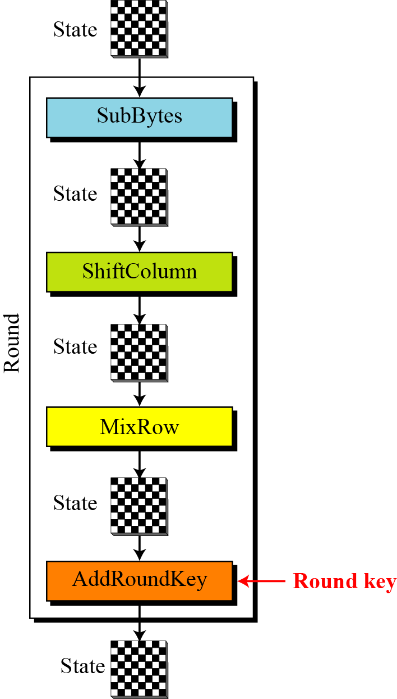
Structure of Each Round
Figure 12.15 shows the structure of each round. Each round uses four transformations.
.

Slide 92
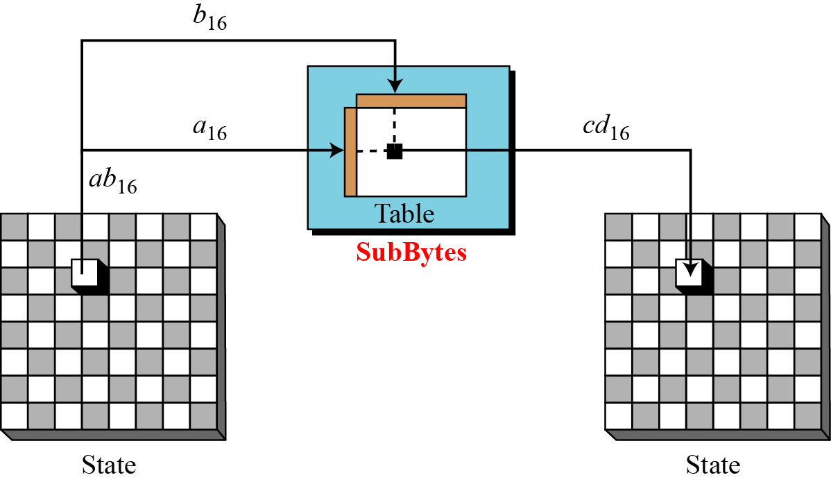
SubBytes Like in AES, SubBytes provide a nonlinear transformation.
A byte is represented as two hexadecimal digits.
Left digit defines the row and right digit defines the column of the substitution table.
Two hexadecimal digits at the junction of the row and the column are the new byte.
Figure 12.16 SubBytes transformations in the Whirlpool cipher
.

Slide 93
In the SubBytes transformation, the state is treated as an 8 × 8 matrix of bytes.
Transformation is done one byte at a time.
The contents of each byte are changed, but the arrangement of the bytes in the matrix remains the same.
Table 12.4 shows the substitution table (S-Box) for SubBytes transformation.
The transformation definitely provides confusion effect.
.

Slide 94
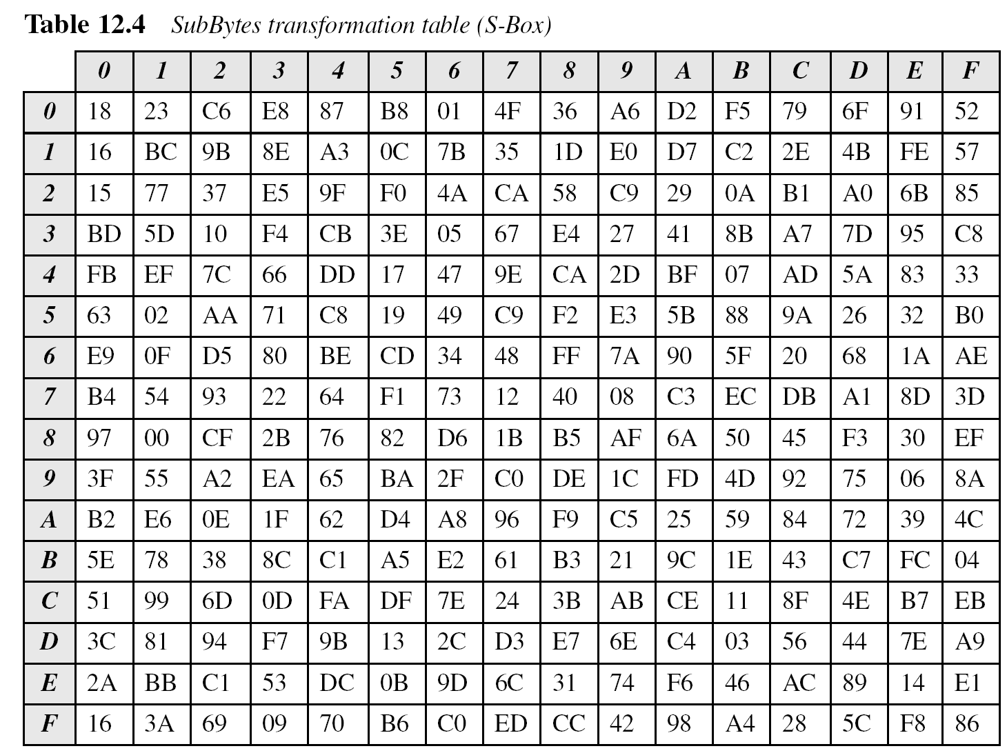
For example, two bytes, 5A₁₆ and 5B₁₆, which differ only in one bit (the rightmost bit), are transformed to 5B₁₆ and 88₁₆, which differ in five bits.
.

Slide 95
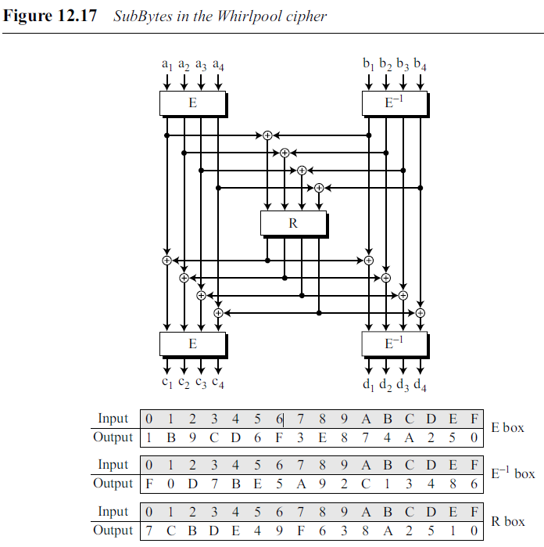

The entries in Table 12.4 can be calculated algebraically using the GF(2⁴) field with the irreducible polynomials (x⁴ + x + 1).
Each hexadecimal digit in a byte is the input to a minibox (E and E⁻¹).
The results are fed into another minibox, R.
The E boxes calculate the exponential of input hexadecimal; the R box uses a pseudorandom number generator.
The E−1 box is just the inverse of the E box where the roles of input and output are changed.
The input/output values for boxes are also tabulated in Figure 12.17.
.

Slide 96
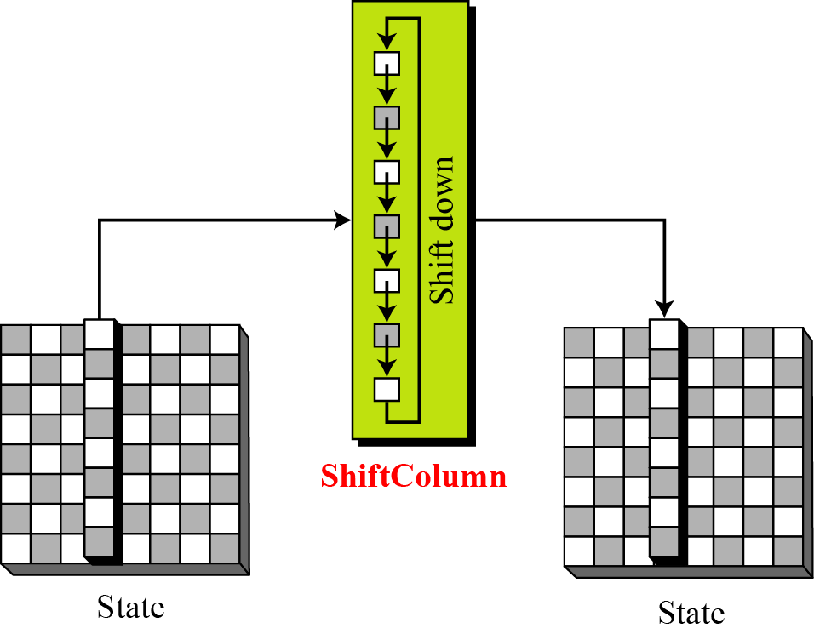
ShiftColumns
To provide permutation, Whirlpool uses the ShiftColumns transformation, which is similar to the ShiftRows transformation in AES, except that the columns instead of rows are shifted.
Shifting depends on the position of the column.
Column 0 goes through 0-byte shifting (no shifting), while column 7 goes through 7-byte shifting.
.

Slide 97
MixRows
The MixRows transformation has the same effect as the MixColumns transformation in AES: it diffuses the bits.
The MixRows transformation is a matrix transformation where bytes are interpreted as 8-bit words (or polynomials) with coefficients in GF(2).
Multiplication of bytes is done in GF(2⁸), but the modulus is different from the one used in AES.
The Whirlpool cipher uses (0x11D) or (x⁸ + x⁴ + x³ + x² + 1) as the modulus.
Addition is the same as XORing of 8-bit words.
.

Slide 98
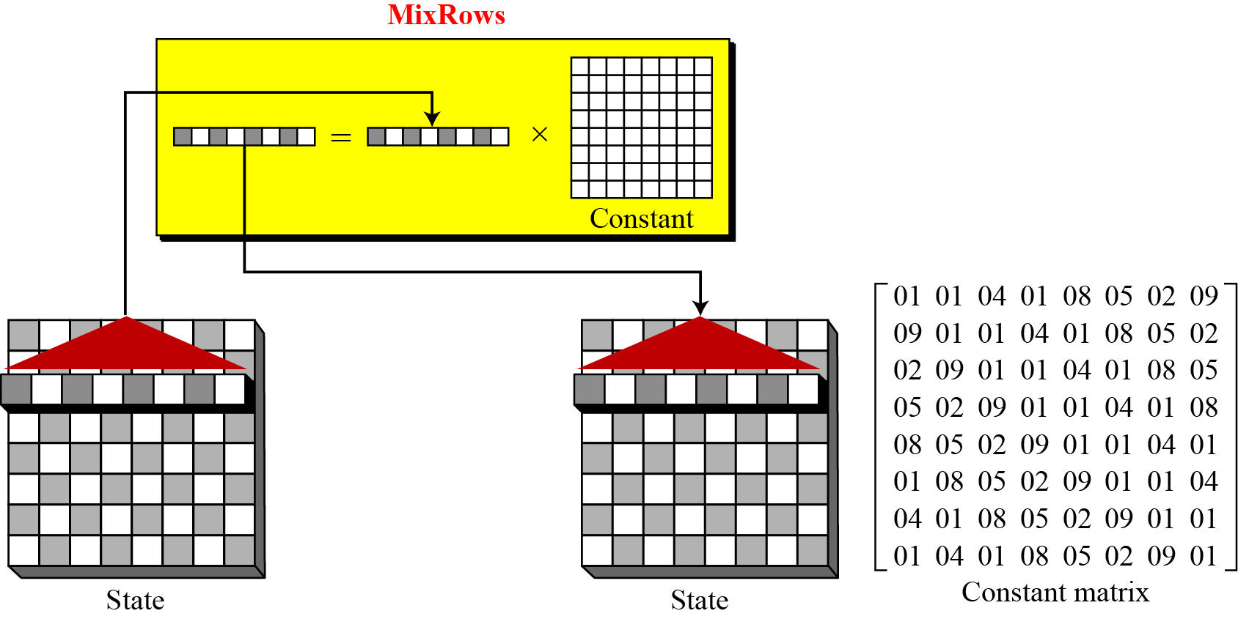
Figure 12.19 MixRows transformation in the Whirlpool cipher
.

Slide 99
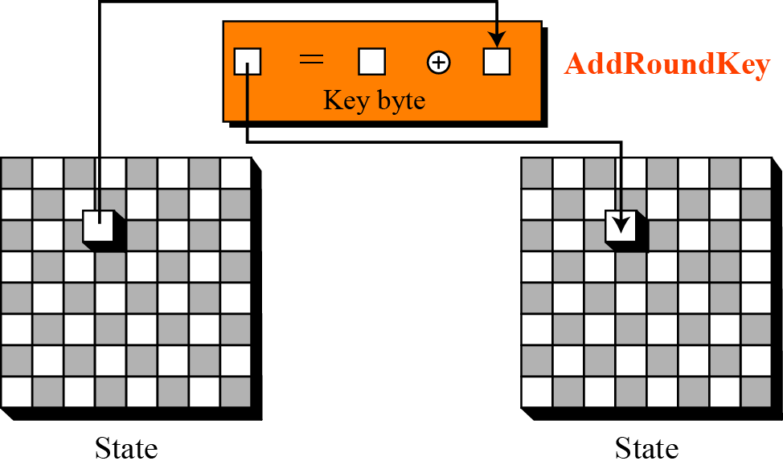
AddRoundKey
The AddRoundKey transformation in the Whirlpool cipher is done byte by byte, because each round key is also a state of an 8 × 8 matrix.
A byte from the data state is added, in GF(2⁸) field, to the corresponding byte in the round-key state.
The result is the new byte in the new state.
Figure 12.20 AddRoundKey transformation in the Whirlpool cipher
.

Slide 100
Key Expansion
Key-expansion algorithm in Whirlpool is totally different from the algorithm in AES.
Instead of using a new algorithm for creating round keys, Whirlpool uses a copy of the encryption algorithm (without the pre-round) to create the round keys.
The output of each round in the encryption algorithm is the round key for that round.
Whirlpool uses ten round constants (RCs) as the virtual round keys for the keyexpansion algorithm.
In other words, the key-expansion algorithm uses constants as the round keys and the encryption algorithm uses the output of each round of the keyexpansion algorithm as the round keys.
The key-generation algorithm treats the cipher key as the plaintext and encrypts it.
Note that the cipher key is also K₀ for the encryption algorithm
.

Slide 101
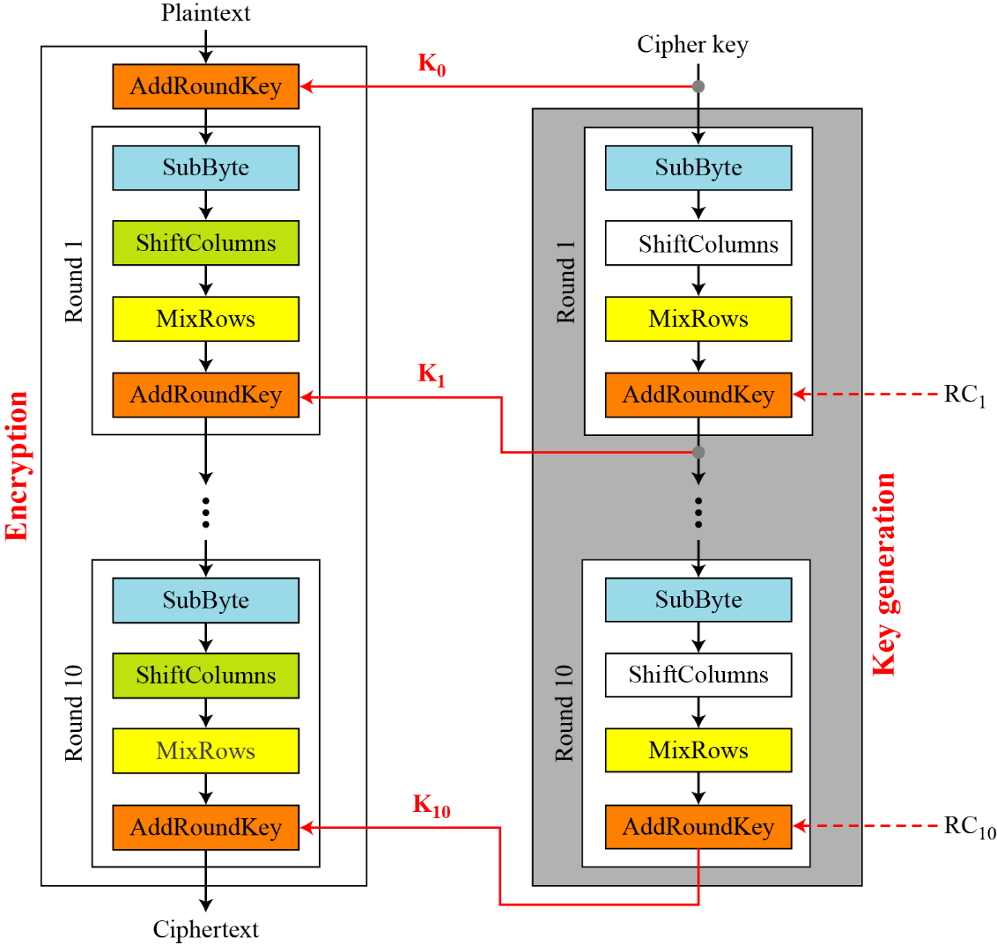
.

Slide 102
Round Constants Each round constant, RCr is an 8 × 8 matrix where only the first row has non-zero values.
The rest of the entries are all 0’s.
The values for the first row in each constant matrix can be calculated using the SubBytes transformation (Table 12.4).
.

Slide 103
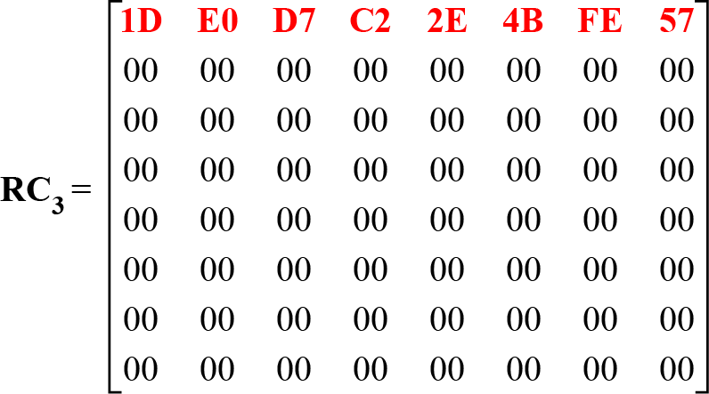
In other words, RC1 uses the first eight entries in the SubBytes transformation table
[Table 12.4]; RC2 uses the second eight entries, and so on.
For example, Figure 12.22 shows RC3, where the first row is the third eight entries in the SubBytes table.
Figure 12.22 Round constant for the third round
.

Slide 104
Summary
Table 12.5 summarizes some characteristics of the Whirlpool cipher.
.

Slide 105
Analysis
Although Whirlpool has not been extensively studied or tested, it is based on a robust scheme (Miyaguchi-Preneel), and for a compression function uses a cipher that is based on AES, a cryptosystem that has been proved very resistant to attacks.
In addition, the size of the message digest is the same as for SHA-512.
Therefore it is expected to be a very strong cryptographic hash function.
However, more testing and researches are needed to confirm this.
The only concern is that Whirlpool, which is based on a cipher as the compression function, may not be as efficient as SHA-512, particularly when it is implemented in hardware.
.

Slide 106
END
.

